Slide 1
Topic: Scale Drawings
EQ: How do I interpret House Plans?

Slide 2
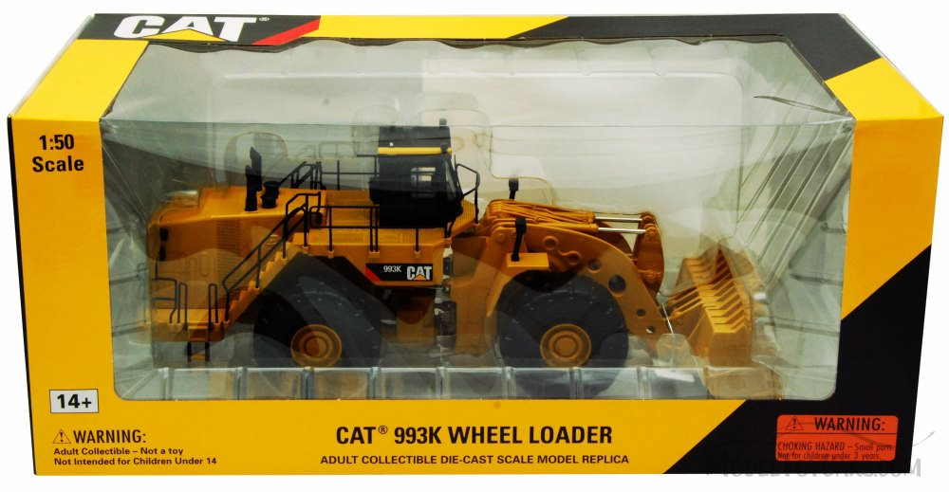
FROM LAST LESSON: Think, Pair, Share What is the scale? What does this mean?

Slide 3


Solution
Writing
A scale of 1 : 50 means that 1 unit of the scale is equal to 50 units actual distance.
For the scale model 1cm of the model equals 50 cm actual distance.
If the scale model is 20cm long. How long is a loader?
$$1:50$$
$$1cm:50cm$$
$$20cm: 1000 cm$$
1000cm = 10m
So the loader is 10m.
x20
x20

Slide 4
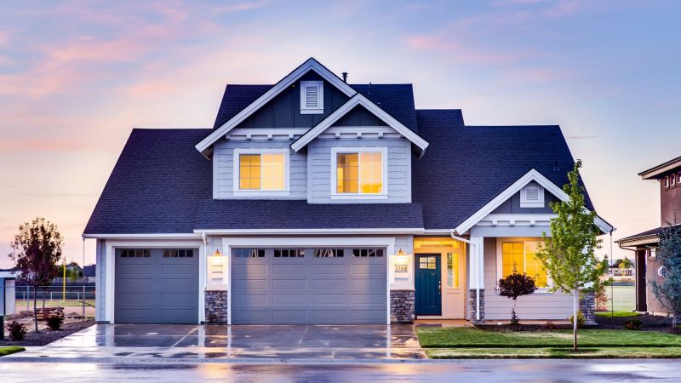
24
7
30
House Plans
Date
EQ – How do we interpret house plans?
What is a house plan?
Each building must have plans drawn up before it can be build. These scale diagrams are called house plans
House plans use many symbols and abbreviations
Most house plan measurements are shown in millimetres to avoid using a decimal point, which can lead to errors in printing
House plans are also used to work out
how much materials are needed to
decorate the room or house

Slide 5
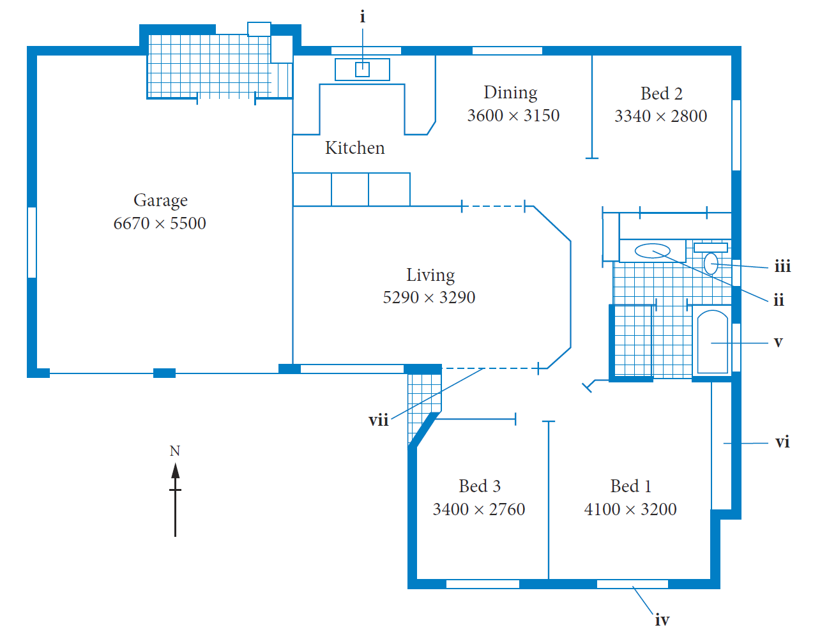
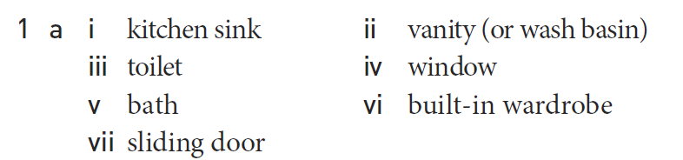
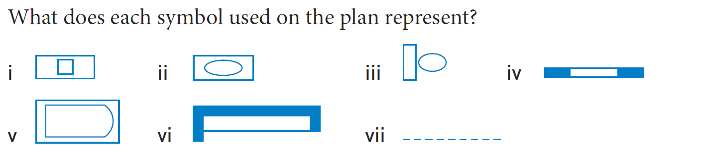
Practice

Slide 6
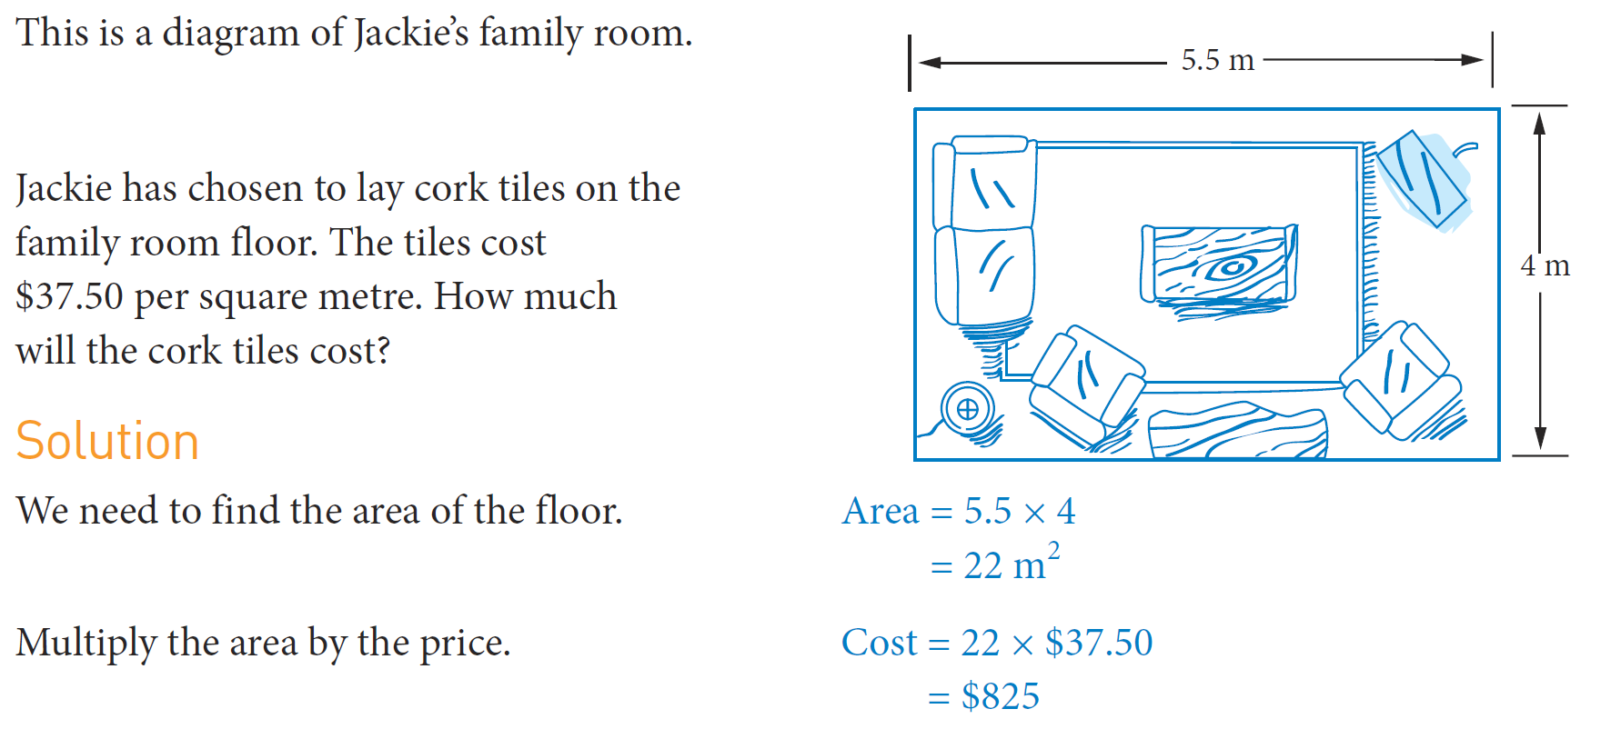
Practice

Slide 7
Task
Interpreting an office plan Worksheet

